Slide 1


Slide 2
BH60M & BH100 with Electronic Transmission
Securing the CAN J1939 2.0B Communication Protocol, to make RIDES SAFER!

Slide 3
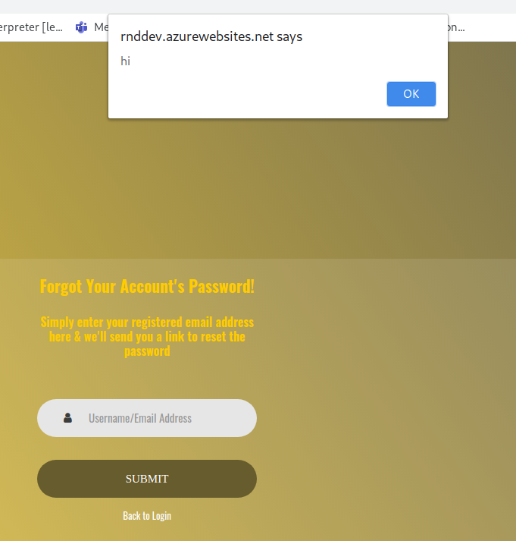
Cross Site Scripting is not validated

Slide 4
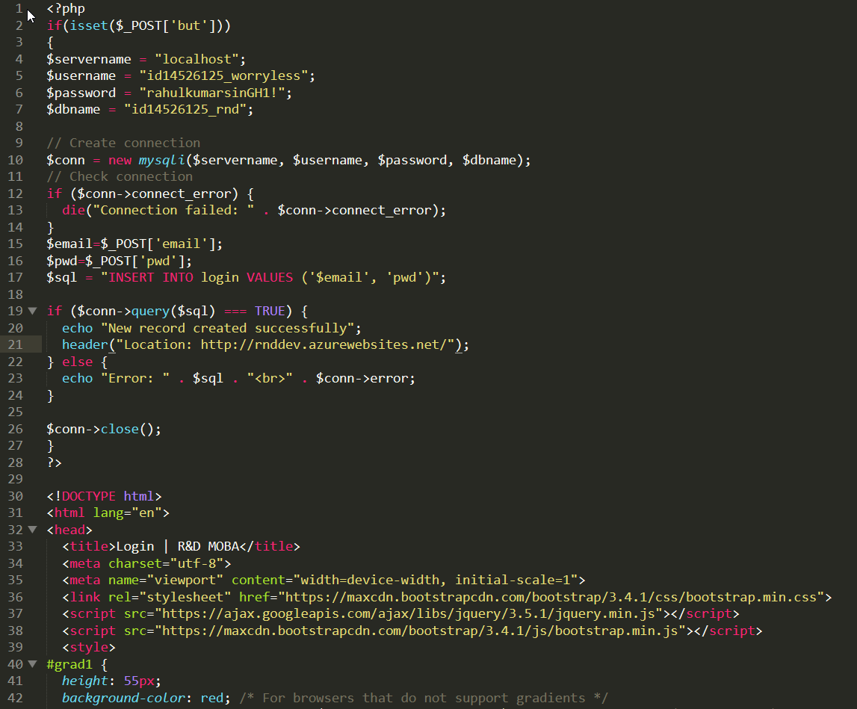
Code “Same as the Login page”

Slide 5
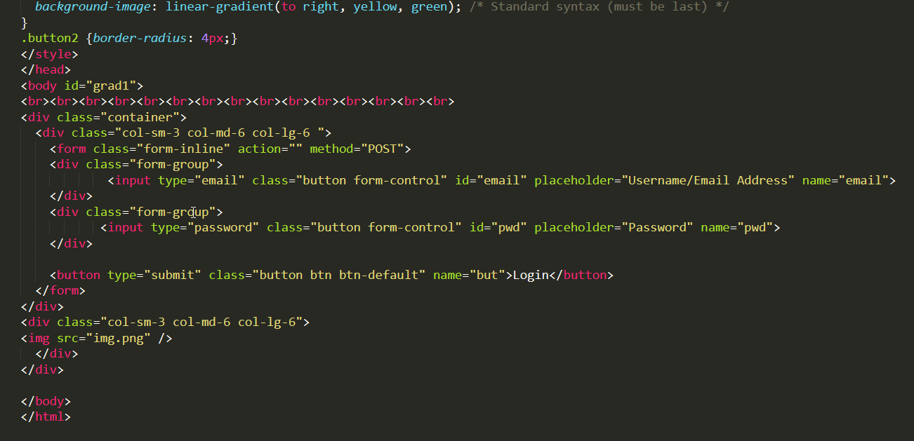
Code “Same as the Login page”

Slide 6
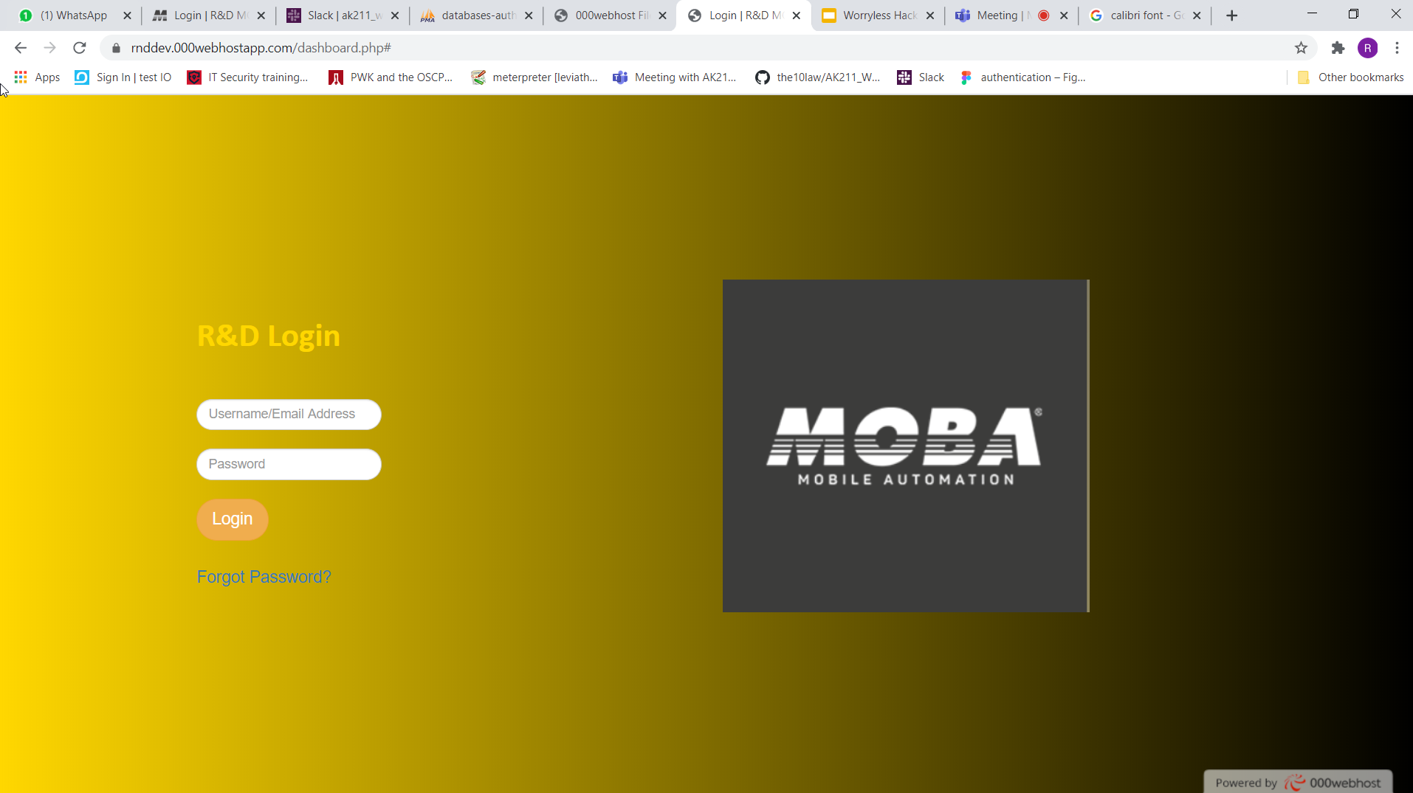
Original Website

Slide 7
Page Duplicate “Same as the Login page”

Slide 8

Stored in DB

